Slide 1
Term | Meaning
Application | User program built on Spark. Consists of a driver program and executors on the cluster.
Application jar | A jar containing the user's Spark application. In some cases users will want to create an "uber jar" containing their application along with its dependencies. The user's jar should never include Hadoop or Spark libraries, however, these will be added at runtime.
Driver program | The process running the main() function of the application and creating the SparkContext
Cluster manager | An external service for acquiring resources on the cluster (e.g. standalone manager, Mesos, YARN)
Deploy mode | Distinguishes where the driver process runs. In "cluster" mode, the framework launches the driver inside of the cluster. In "client" mode, the submitter launches the driver outside of the cluster.
Worker node | Any node that can run application code in the cluster
Executor | A process launched for an application on a worker node, that runs tasks and keeps data in memory or disk storage across them. Each application has its own executors.
Task | A unit of work that will be sent to one executor
Job | A parallel computation consisting of multiple tasks that gets spawned in response to a Spark action (e.g. save, collect); you'll see this term used in the driver's logs.
Stage | Each job gets divided into smaller sets of tasks called stages that depend on each other (similar to the map and reduce stages in MapReduce); you'll see this term used in the driver's logs.

Slide 2
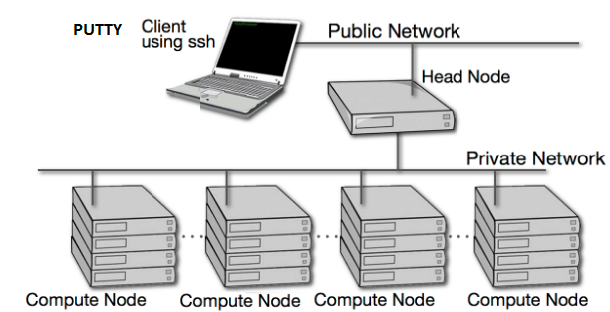
Computing Cluster - Access through PUTTY
us0789lnxp.america.apci.com
901
902
903
904

Slide 3
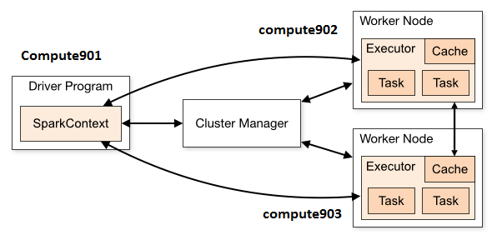
Driver Program

Slide 4
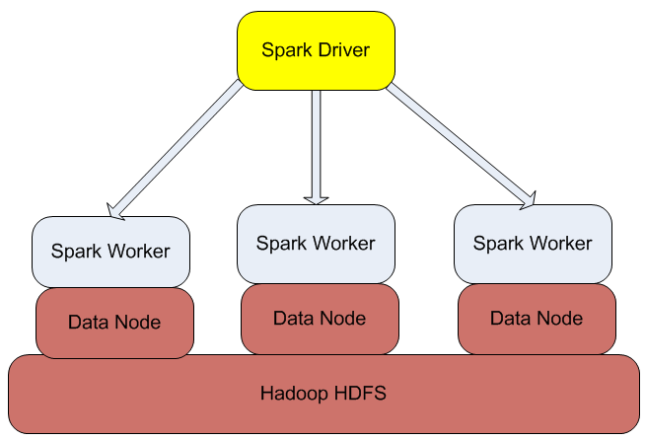
Spark Over HDFS
Compute901
Compute902
Compute903
Compute904

Slide 5
Driver Program
Spark applications run as independent sets of processes on a cluster, coordinated by the SparkContext object in your main program (called the driver program).
import numpy as np
from pyspark import SparkContext
if __name__ == "__main__":
sc = SparkContext(appName="RDD with auto parallelization")
# create array
index = np.arange(100)
p_index = sc.parallelize(index)
res = p_index.map(lambda a: a*5).()
print(res)
sc.stop();

Slide 6
Driver Program - Cluster Manager
Specifically, to run on a cluster, the SparkContext can connect to several types of cluster managers (either Spark’s own standalone cluster manager or Mesos/YARN), which allocate resources across applications.
Once connected, Spark acquires executors on nodes in the cluster, which are processes that run computations and store data for your application. Next, it sends your application code (defined by JAR or Python files passed to SparkContext) to the executors. Finally, SparkContext sends tasks for the executors to run.
>spark-submit driver.py --master <clusterManager>
Cluster Manager (--master) options
Local
local[K]
local[*]
spark://Host:Port

Slide 7
Defining Spark Distribution
--master
local Run Spark locally with one worker thread (i.e. no parallelism at all).
local[K] Run Spark locally with K worker threads (ideally, set this to the number of cores on your machine).
local[*] Run Spark locally with as many worker threads as logical cores on your machine.
spark://HOST:PORT Connect to the given Spark standalone cluster master. The port must be whichever one your master is configured to use, which is 7077 by default.

Slide 8
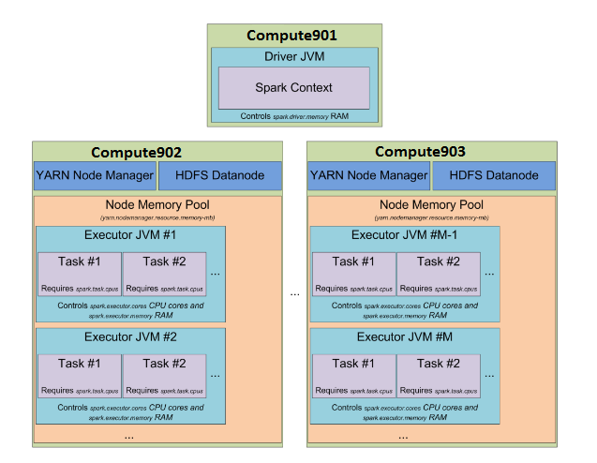
Worker Nodes

Slide 9
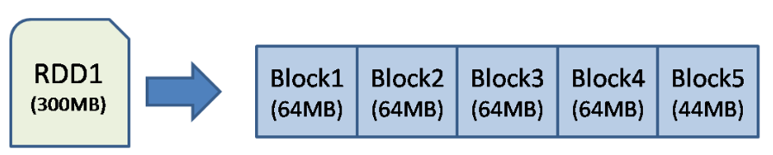
RDD
Spark works on the concept of RDDs – Resilient Distributed Datasets. RDDs are data that are distributed over a cluster of machines and are resilient. Resilient means that they can be rebuilt on failure based on the information stored. Spark works by applying a series of transformations to the RDDs. RDDs can be initially created by loading data from local storage or from HDFS. Then a series of transformations are applied to RDDs to get the resultant RDD.
Spark is storing an RDD called RDD1 which is 300MB in size. This RDD is stored using HDFS with a default replication factor of 3 and block size of 64MB.

Slide 10
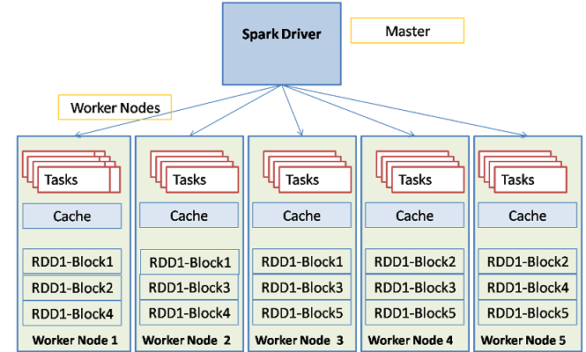
RDD cont’d Spark architecture is similar to hadoop in that it works with cluster of machines in a master-worker architecture. The architecture can be represented by the following diagram:

Slide 11
Stages & Jobs
Invoking an action inside a Spark application triggers the launch of a job to fulfill it. Spark examines the dataset on which that action depends and formulates an execution plan. The execution plan assembles the dataset transformations into stages. A stage is a collection of tasks that run the same code, each on a different subset of the data.

Slide 12
Spark Executor
Every Spark executor in an application has the same fixed number of cores and same fixed heap size. The number of cores can be specified with the flag when invoking spark-submit, spark-shell, and pyspark from the command line, or by setting the property in the file or on a object.

Slide 13
Num Executors
This applies to YARN mode. The --num-executors defines the number of executors, which really defines the total number of applications that will be run. You can specify the --executor-cores which defines how many CPU cores are available per executor/application. Given that, the answer is the first: you will get 5 total executors.

Slide 14
Configuring number of cores
It is a good point that each JVM-based worker can have multiple "cores" that run tasks in a multi-threaded environment. There are benefits to running multiple executors on a single node (single JVM) to take advantage of the multi-core processing power, and to reduce the total JVM overhead per executor. Obviously, the JVM has to startup and initialize certain data structures before it can begin running tasks.
From Spark docs, we configure number of cores using these parameters:
spark.driver.cores = Number of cores to use for the driver process
spark.executor.cores = The number of cores to use on each executor
You also want to watch out for this parameter, which can be used to limit the total cores used by Spark across the cluster (i.e., not each worker):
spark.cores.max = the maximum amount of CPU cores to request for the application from across the cluster (not from each machine)

Slide 15
Level of Parallelism
Clusters will not be fully utilized unless you set the level of parallelism for each operation high enough. Spark automatically sets the number of “map” tasks to run on each file according to its size (though you can control it through optional parameters to SparkContext.textFile, etc), and for distributed “reduce” operations, such as groupByKey and reduceByKey, it uses the largest parent RDD’s number of partitions. You can pass the level of parallelism as a second argument (see the spark.PairRDDFunctions documentation), or set the config property spark.default.parallelism to change the default. In general, we recommend 2-3 tasks per CPU core in your cluster.

Slide 16
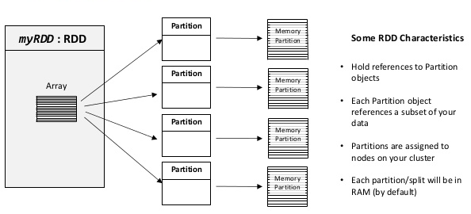
RDD Characteristics

Slide 17
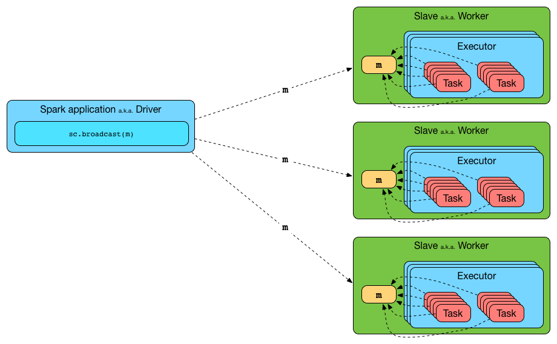
Broadcasting Large Variables
Using the broadcast functionality available in SparkContext can greatly reduce the size of each serialized task, and the cost of launching a job over a cluster. If your tasks use any large object from the driver program inside of them (e.g. a static lookup table), consider turning it into a broadcast variable. Spark prints the serialized size of each task on the master, so you can look at that to decide whether your tasks are too large; in general tasks larger than about 20 KB are probably worth optimizing.

Slide 18
Data Locality
Data locality can have a major impact on the performance of Spark jobs. If data and the code that operates on it are together then computation tends to be fast. But if code and data are separated, one must move to the other. Typically it is faster to ship serialized code from place to place than a chunk of data because code size is much smaller than data. Spark builds its scheduling around this general principle of data locality.
Data locality is how close data is to the code processing it. There are several levels of locality based on the data’s current location. In order from closest to farthest:
PROCESS_LOCAL data is in the same JVM as the running code. This is the best locality possible
NODE_LOCAL data is on the same node. Examples might be in HDFS on the same node, or in another executor on the same node. This is a little slower than PROCESS_LOCAL because the data has to travel between processes
NO_PREF data is accessed equally quickly from anywhere and has no locality preference
RACK_LOCAL data is on the same rack of servers. Data is on a different server on the same rack so needs to be sent over the network, typically through a single switch
ANY data is elsewhere on the network and not in the same rack
Spark prefers to schedule all tasks at the best locality level, but this is not always possible. In situations where there is no unprocessed data on any idle executor, Spark switches to lower locality levels. There are two options: a) wait until a busy CPU frees up to start a task on data on the same server, or b) immediately start a new task in a farther away place that requires moving data there.
What Spark typically does is wait a bit in the hopes that a busy CPU frees up. Once that timeout expires, it starts moving the data from far away to the free CPU. The wait timeout for fallback between each level can be configured individually or all together in one parameter; see thespark.locality parameters on the configuration page for details. You should increase these settings if your tasks are long and see poor locality, but the default usually works well.

Slide 19
Transformation | Meaning
map(func) | Return a new distributed dataset formed by passing each element of the source through a function func.
filter(func) | Return a new dataset formed by selecting those elements of the source on which func returns true.
flatMap(func) | Similar to map, but each input item can be mapped to 0 or more output items (so func should return a Seq rather than a single item).
mapPartitions(func) | Similar to map, but runs separately on each partition (block) of the RDD, so func must be of type Iterator<T> => Iterator<U> when running on an RDD of type T.
mapPartitionsWithIndex(func) | Similar to mapPartitions, but also provides func with an integer value representing the index of the partition, so func must be of type (Int, Iterator<T>) => Iterator<U> when running on an RDD of type T.
sample(withReplacement, fraction, seed) | Sample a fraction fraction of the data, with or without replacement, using a given random number generator seed.
union(otherDataset) | Return a new dataset that contains the union of the elements in the source dataset and the argument.
intersection(otherDataset) | Return a new RDD that contains the intersection of elements in the source dataset and the argument.
distinct([numTasks])) | Return a new dataset that contains the distinct elements of the source dataset.
groupByKey([numTasks]) | When called on a dataset of (K, V) pairs, returns a dataset of (K, Iterable<V>) pairs. Note: If you are grouping in order to perform an aggregation (such as a sum or average) over each key, using reduceByKey or aggregateByKey will yield much better performance. Note: By default, the level of parallelism in the output depends on the number of partitions of the parent RDD. You can pass an optional numTasks argument to set a different number of tasks.
reduceByKey(func, [numTasks]) | When called on a dataset of (K, V) pairs, returns a dataset of (K, V) pairs where the values for each key are aggregated using the given reduce function func, which must be of type (V,V) => V. Like in groupByKey, the number of reduce tasks is configurable through an optional second argument.
aggregateByKey(zeroValue)(seqOp, combOp, [numTasks]) | When called on a dataset of (K, V) pairs, returns a dataset of (K, U) pairs where the values for each key are aggregated using the given combine functions and a neutral "zero" value. Allows an aggregated value type that is different than the input value type, while avoiding unnecessary allocations. Like in groupByKey, the number of reduce tasks is configurable through an optional second argument.
sortByKey([ascending], [numTasks]) | When called on a dataset of (K, V) pairs where K implements Ordered, returns a dataset of (K, V) pairs sorted by keys in ascending or descending order, as specified in the boolean ascending argument.
join(otherDataset, [numTasks]) | When called on datasets of type (K, V) and (K, W), returns a dataset of (K, (V, W)) pairs with all pairs of elements for each key. Outer joins are supported through leftOuterJoin, rightOuterJoin, and fullOuterJoin.
cogroup(otherDataset, [numTasks]) | When called on datasets of type (K, V) and (K, W), returns a dataset of (K, (Iterable<V>, Iterable<W>)) tuples. This operation is also called groupWith.
cartesian(otherDataset) | When called on datasets of types T and U, returns a dataset of (T, U) pairs (all pairs of elements).
pipe(command, [envVars]) | Pipe each partition of the RDD through a shell command, e.g. a Perl or bash script. RDD elements are written to the process's stdin and lines output to its stdout are returned as an RDD of strings.
coalesce(numPartitions) | Decrease the number of partitions in the RDD to numPartitions. Useful for running operations more efficiently after filtering down a large dataset.
repartition(numPartitions) | Reshuffle the data in the RDD randomly to create either more or fewer partitions and balance it across them. This always shuffles all data over the network.
repartitionAndSortWithinPartitions(partitioner) | Repartition the RDD according to the given partitioner and, within each resulting partition, sort records by their keys. This is more efficient than calling repartition and then sorting within each partition because it can push the sorting down into the shuffle machinery.

Slide 20
yarn logs -applicationId application_1487622458774_0127

